Slide 1

MINI - Project Presentation
Topic - “ GamingZone – Live Online Gaming Website ”
Submitted By :-
Abhishek Tiwari (181500029)
Jatin Agrawal (181500293),
Manish Gautam(181500366),
Rahul Saraswat(181500537)
Department of Computer Engineering and Applications
Institute of Engineering and Technology
GLA University
Mathura-281406, India

Slide 2

PROBLEM STATEMENT
What are we creating
We are creating “A real-time Live Online Gaming website.”
The problem statement is to propose a system that is meant to give more easiness to the users that they can easily access to the games.
Also, to provide various games options for a user

Slide 3

What is the Idea ?
In today’s era, we all are aware of our daily changing requirements and the need to entertain as in this world of full of tasks and jobs.
Online Gaming via this interface make us elevate from being digitally literate to digitally fluent, collaborate using appropriate virtual tools and system and that are cost-effective and environment friendly too. So, putting our efforts into this application, we are going to create “GamingZone”.

Slide 4

Motivation Behind.…
Gaming gives relaxation and enjoyment to every user. In this busy world, gaming is the solution to release the depression and tension. Social networking with gaming is a nice combo for any user who feels relaxed in playing games. The requirements specified in this document will be used for designing all the aspects and components of the game. The document will be updated as the requirements grow and change over the design and development process.

Slide 5

Technologies Used
For the completion of the task the following Web-languages and scripts have been used:
HTML
CSS
JavaScript
Bootstrap

Slide 6
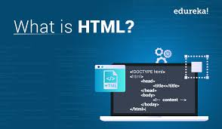
HTML
HTML stands for Hypertext Markup Language, and
it is the most widely used language to write Web Pages.
Hypertext refers to the way in which HTML documents are linked together.
Thus, the link available on a webpage is called Hypertext.
As its name suggests, HTML is a Markup Language which means you use HTML to simply "mark-up" a text document with tags that tell a Web browser how to structure it to display.
HTML is being widely used to format web pages with the help of different tags available in HTML language.
HTML is the language for publishing web pages on the WWW (World-Wide Web).
HTML is a Document Description Language (aka Document Markup Language).
HTML is NOT a programming language like C/C++/C#/Java, which is used to implement programming algorithm.
You need a web browser to view the HTML pages. The web browsers do not display the HTML tags, but uses the tags to interpret the content of the web pages.
An HTML document is a text document, and it is human-readable

Slide 7
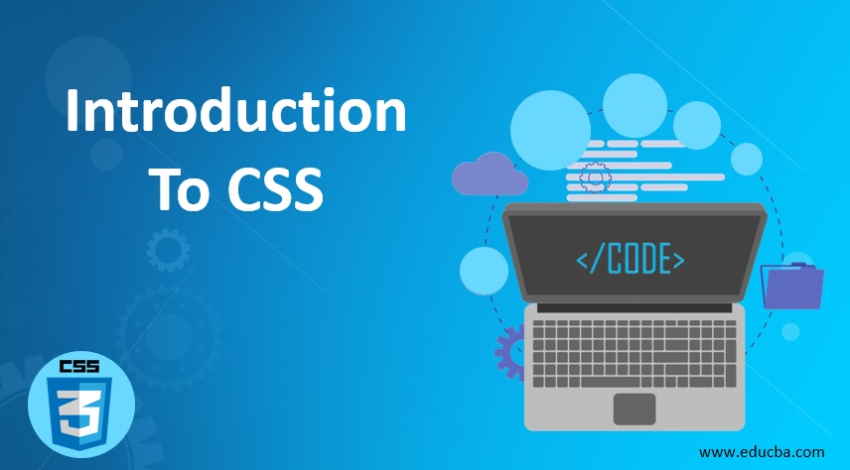
CSS
CSS is acronym for Cascading Style Sheets and is a markup language
responsible for how your web pages will look like.
It controls the colors, fonts, and layouts of your website elements.
It is a style sheet language used for describing the presentation of a document written in a markup language like HTML. CSS is designed to enable the separation of presentation and content, including layout, colors, and fonts.
CSS has a simple syntax and uses a number of English keywords to specify the names of various style properties.
A CSS comprises of style rules that are interpreted by the browser and then applied to the corresponding elements in your document.
Each rule or rule-set consists of one or more selectors, and a declaration block.
A style rule is made of three parts :−
Selector − A selector is an HTML tag at which a style will be applied. This could be any tag like <h1> or <table> etc.
Property − A property is a type of attribute of HTML tag. Put simply, all the HTML attributes are converted into CSS properties. They could be color, border etc.
Value − Values are assigned to properties. For example, color property can have value either red or #F1F1F1 etc.

Slide 8
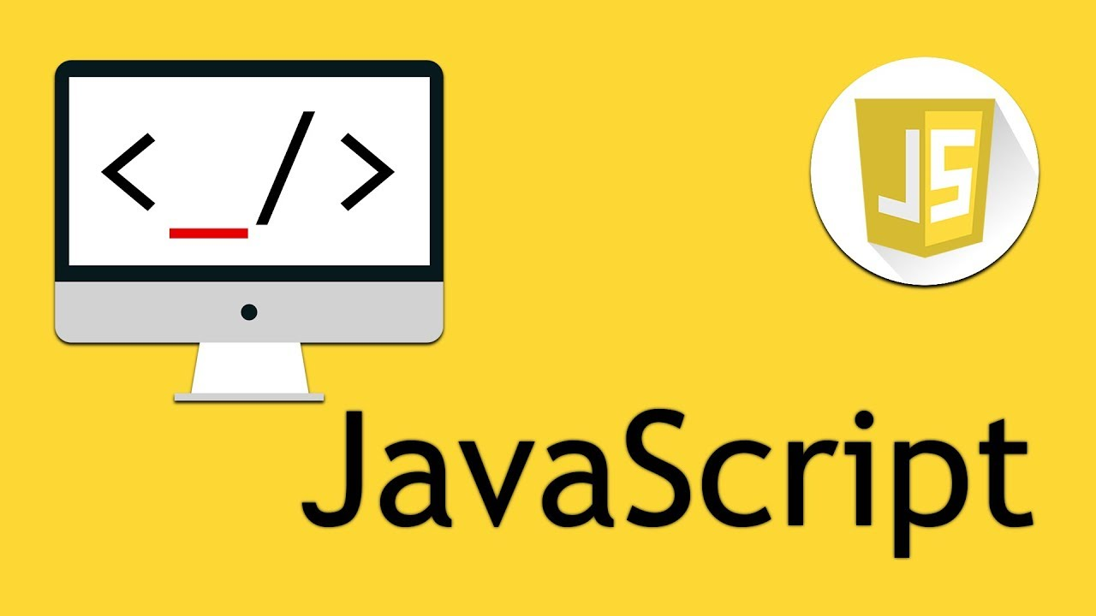
JavaScript
JavaScript is a client-side scripting language and used to build interactive,
Websites with dynamic features and to validate form data.
JavaScript is high-level, dynamic and browser interpreted programming language, supported by all modern web browsers.
Apart from web browser, JavaScript is also used to build scalable web applications using Node JS. JavaScript is also being used widely in game development and Mobile application development.
JavaScript is also known as the Programming Language of web as it is the only programming language for Web browsers. JavaScript is an object-based scripting language which is lightweight and cross-platform.
The programs in this language are called scripts. They can be written right in a web page’s HTML and run automatically as the page loads. Scripts are provided and executed as plain text. They don’t need special preparation or compilation to run.
The browser has an embedded engine sometimes called a “JavaScript virtual machine”.

Slide 9

BOOTSTRAP
Bootstrap is a free and open-source CSS framework directed at responsive, mobile-first front-end web development. It contains CSS - and (optionally) JavaScript-based design templates for typography, forms, buttons, navigation, and other interface components.
Bootstrap is among the most starred projects on GitHub, with more than 142,000 stars, behind freeCodeCamp (almost 312,000 stars) and marginally behind Vue.js framework.
Bootstrap is a HTML, CSS & JS Library that focuses on simplifying the development of informative web pages (as opposed to web apps). The primary purpose of adding it to a web project is to apply Bootstrap's choices of color, size, font and layout to that project. As such, the primary factor is whether the developers in charge find those choices to their liking. Once added to a project, Bootstrap provides basic style definitions for all HTML elements.

Slide 10

Implementation And User Interface (UI):

Slide 11
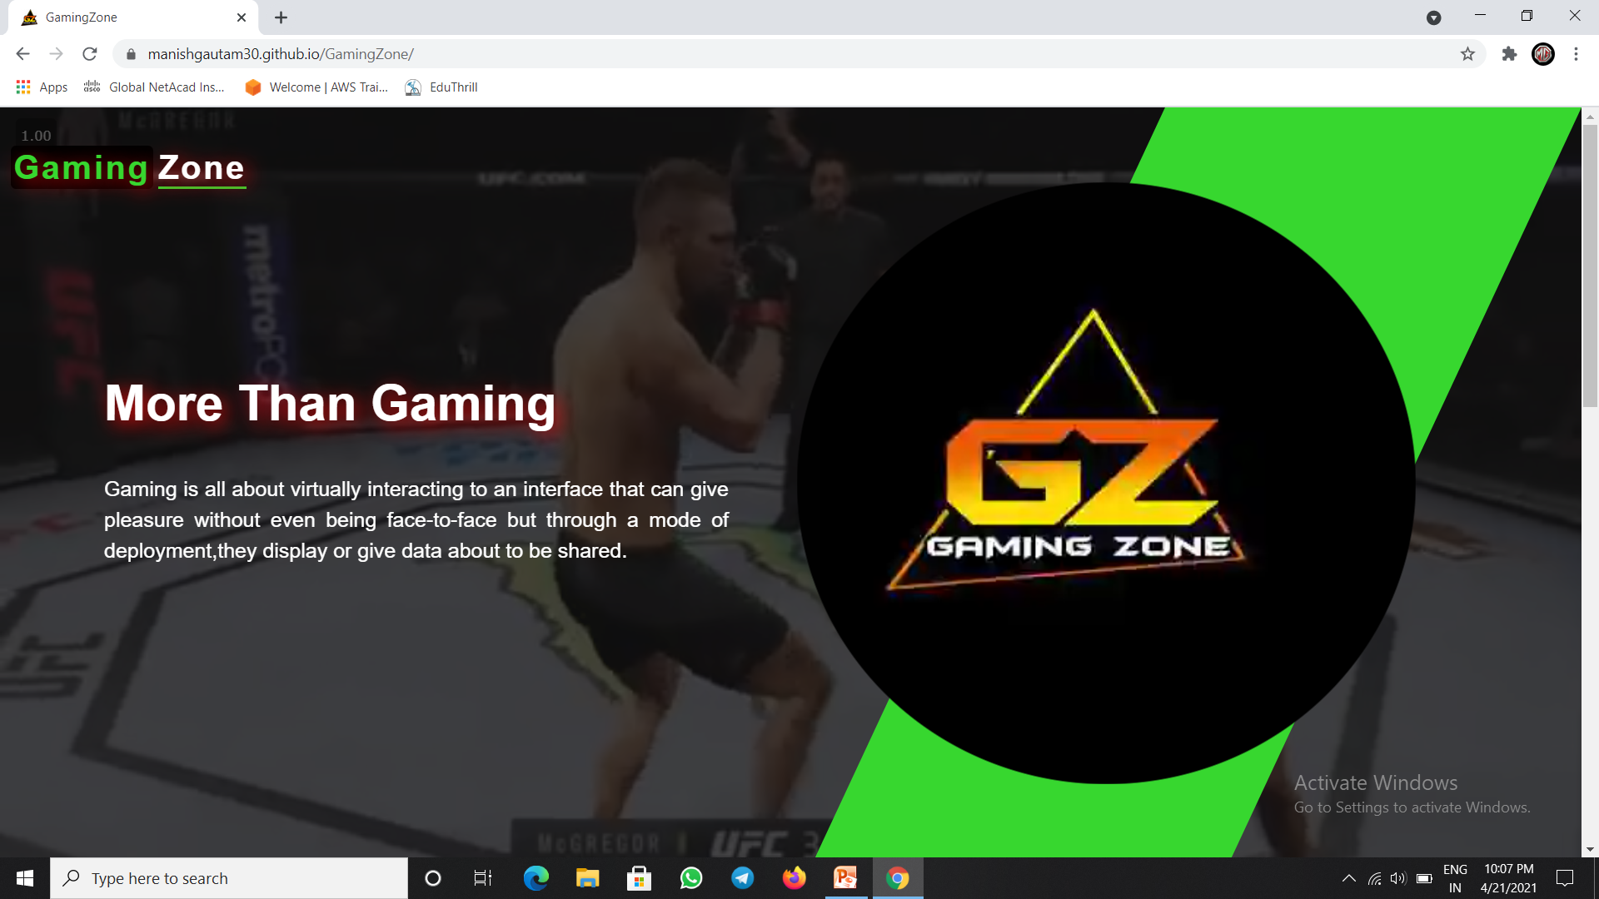
This is the main interface of our Gaming Website.
With a video playback its has our logo.
Website is displayed by a name of GamingZone and a favicon logo left to the name.

Slide 12
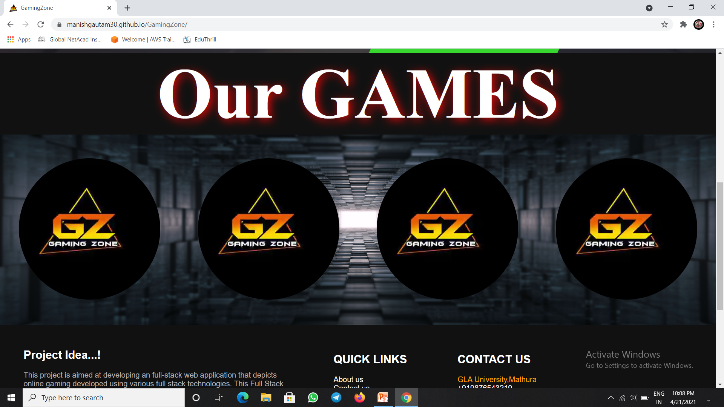
These are the games Uploaded on our Website ,User can access them directly by clicking on the image icons.
Also no need to install any external setup or Gaming environment.

Slide 13
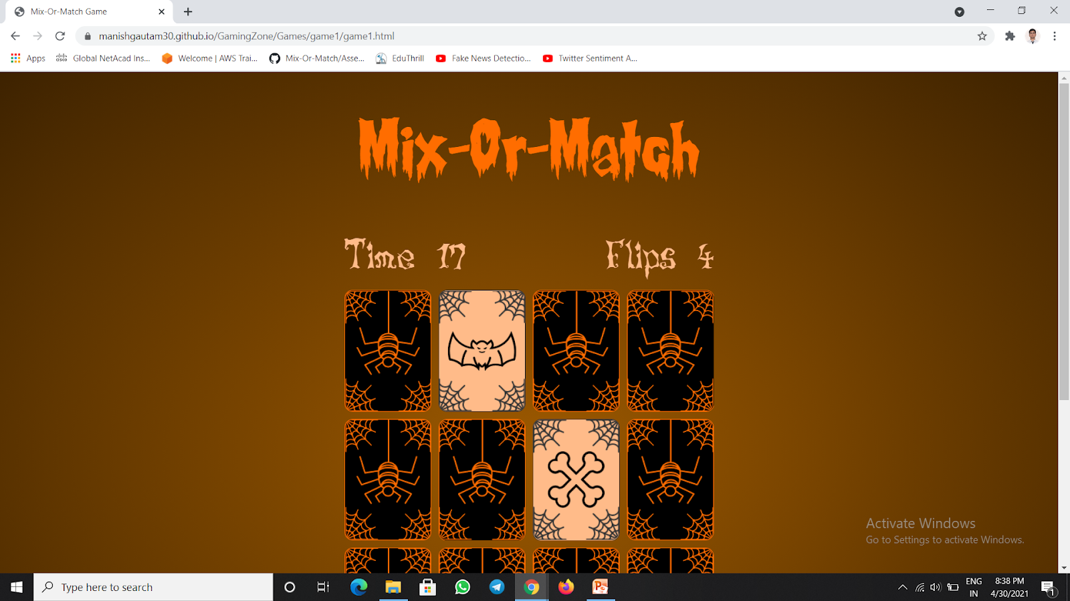
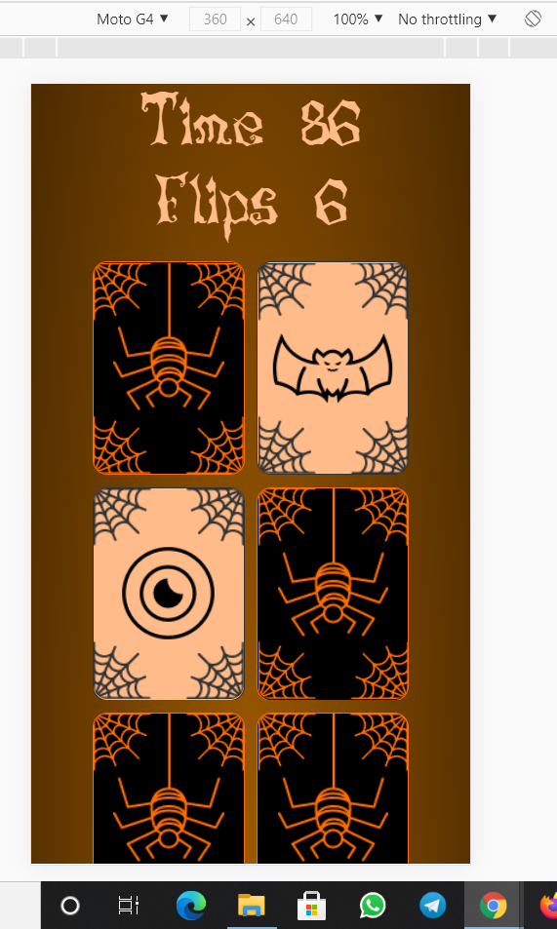
This is our First Game Uploaded on our website also known as Mix-Or-Match GAME.
Responsiveness according to the MOTO – G4 Phone

Slide 14
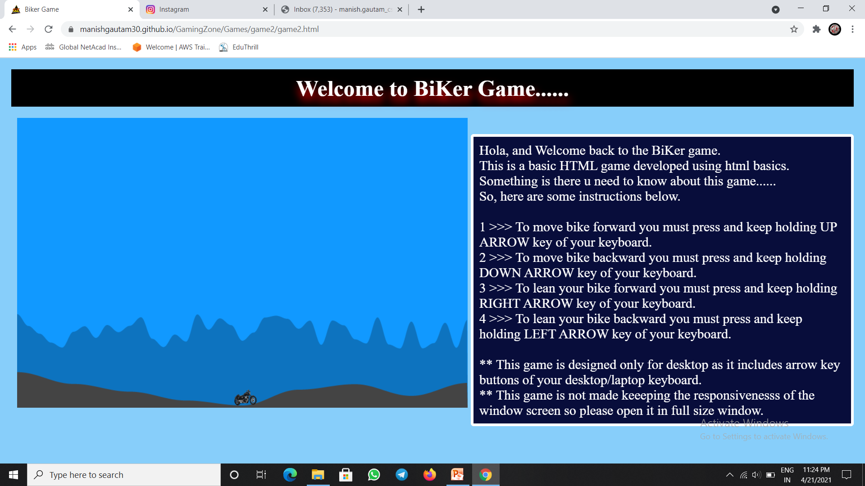
This is our Second Game Uploaded on our website also known as BIKER GAME.

Slide 15
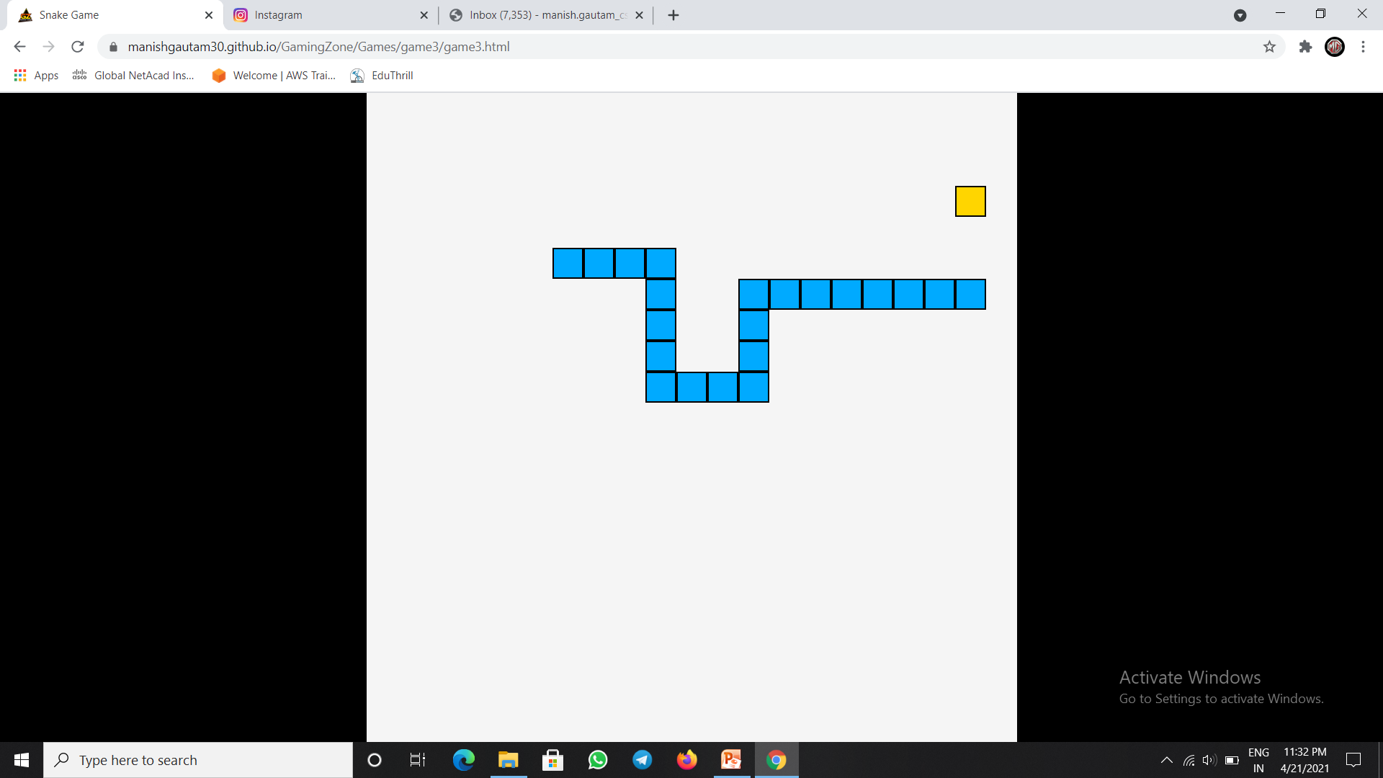
This is our Third Game Uploaded on our website also known as SNAKE GAME.

Slide 16
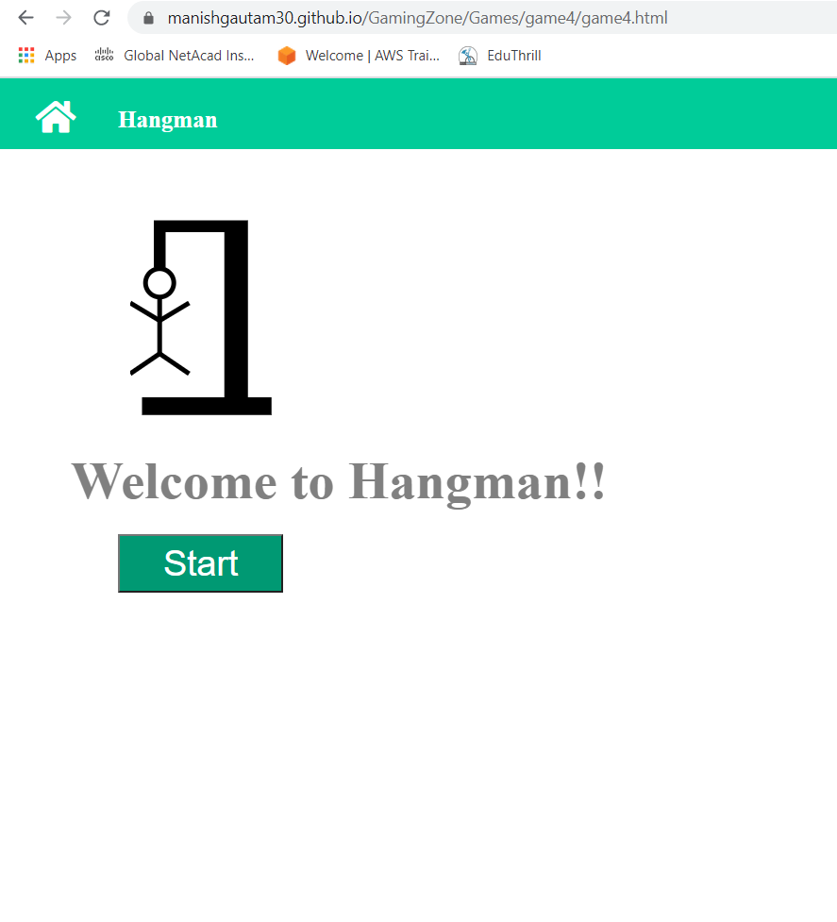
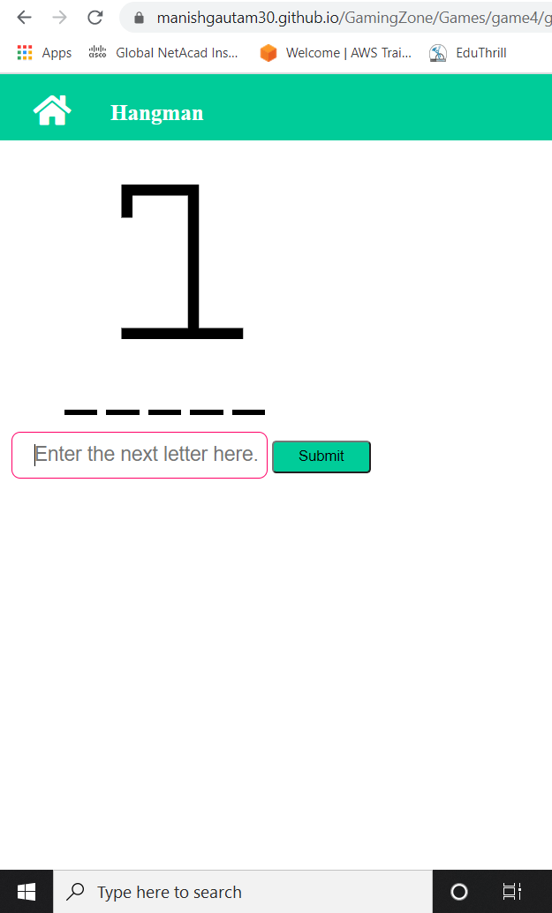
This is our Fourth Game Uploaded on our website also known as HANGMAN GAME.
>>>

Slide 17
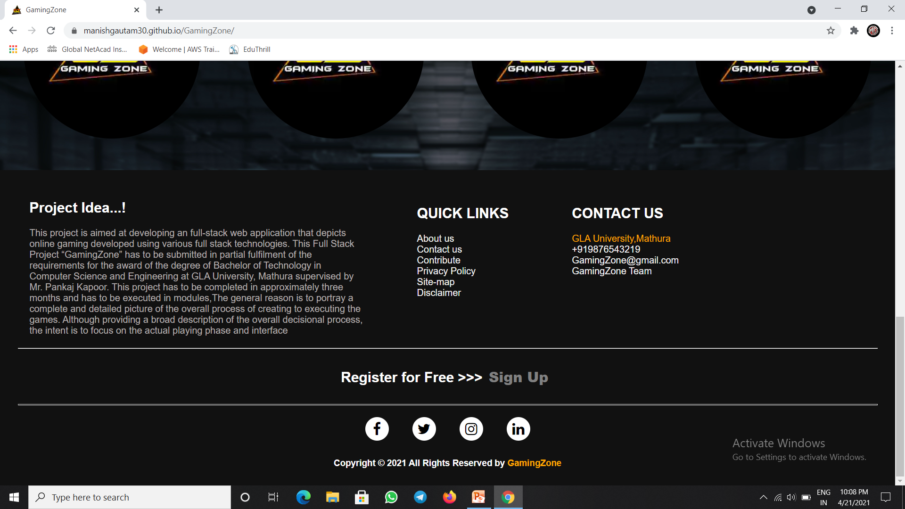
This is the footer with Quick links and Contact info. And have a button to Sign up activity and various social media links.

Slide 18
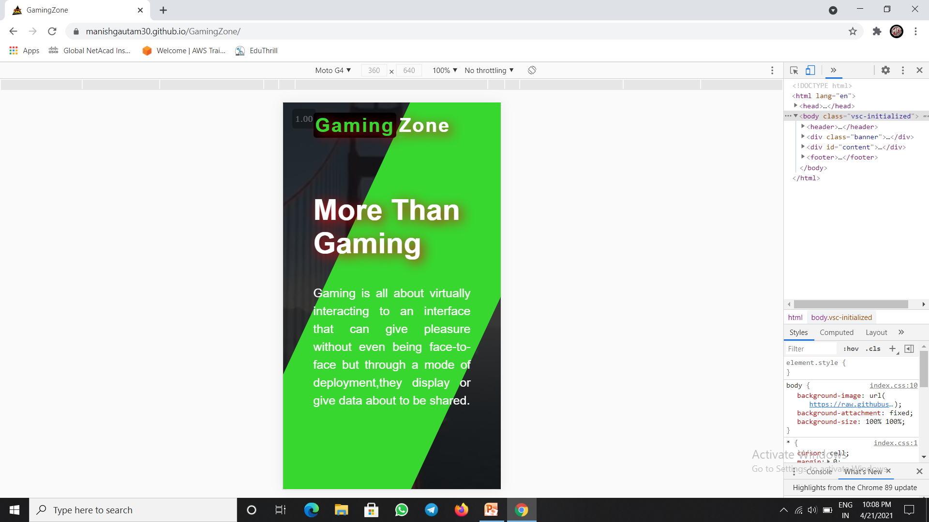
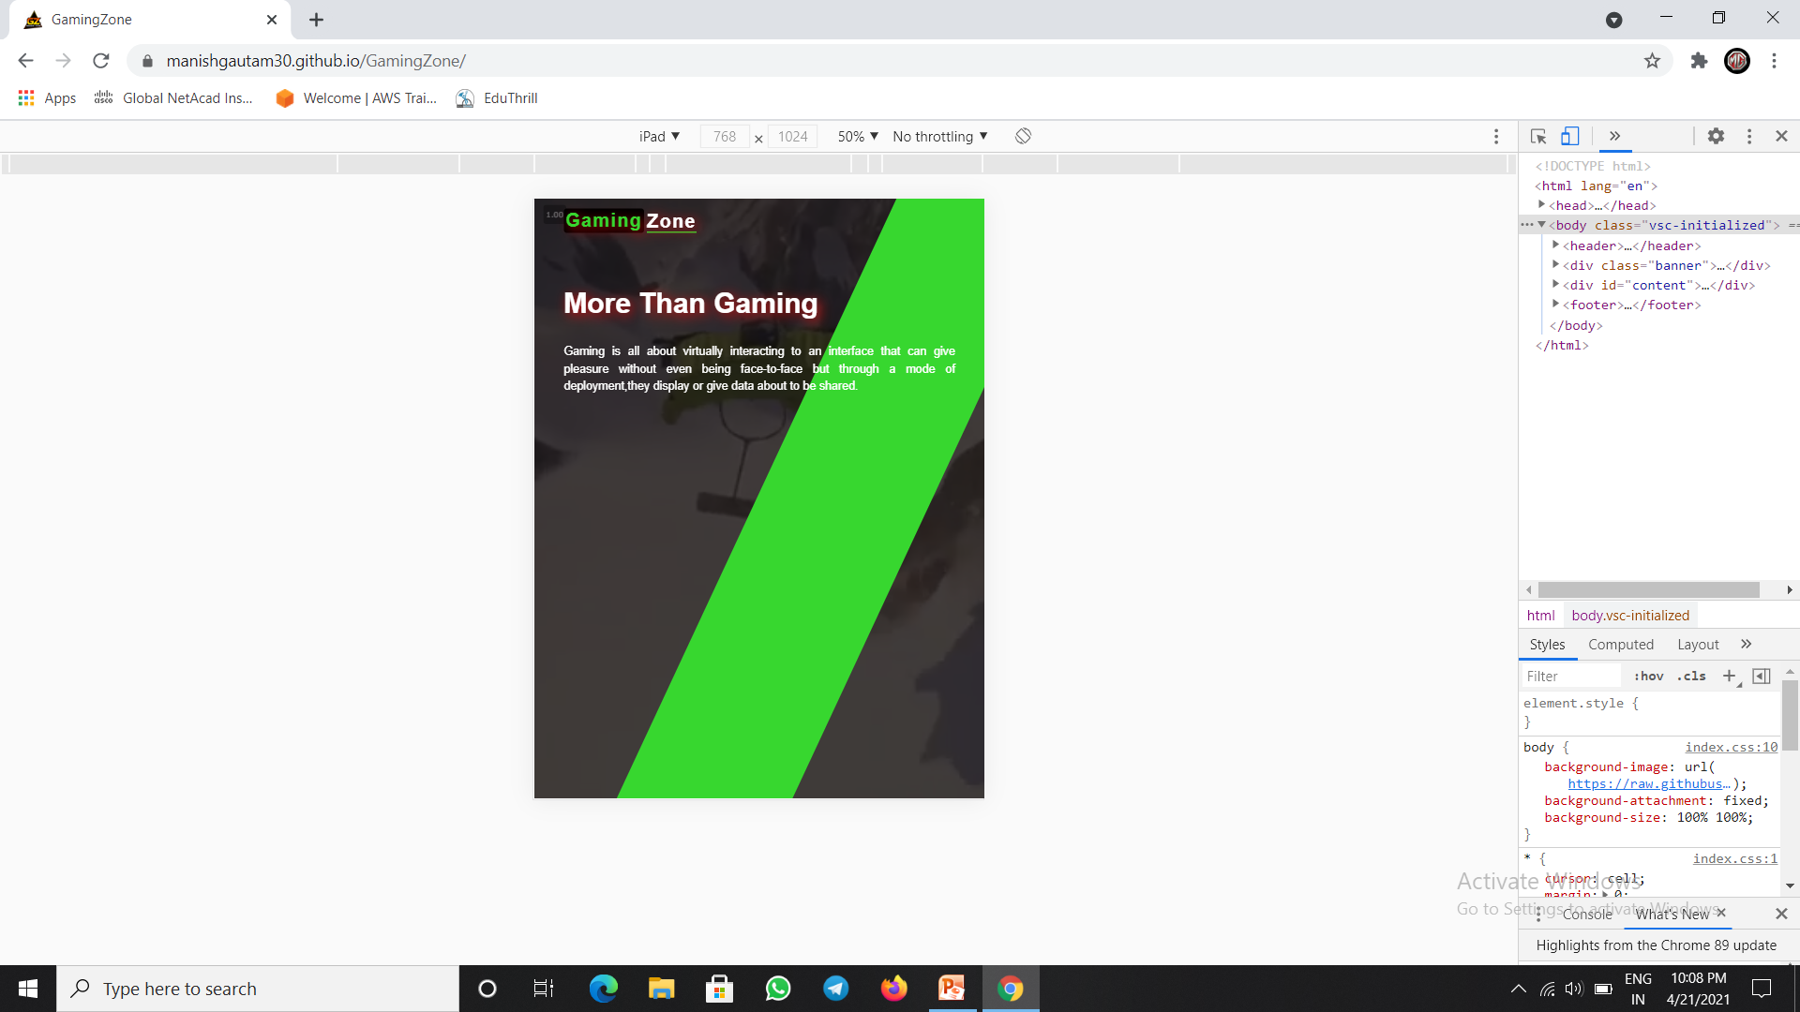
Main container made Responsive with respect to “ Moto G Phone ”
Main container is also made Responsive with respect to “ I Pad ” or any Tablet size Screen.

Slide 19
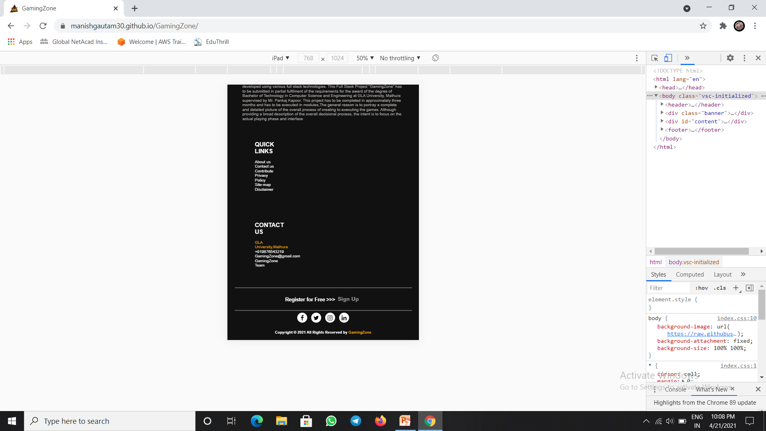
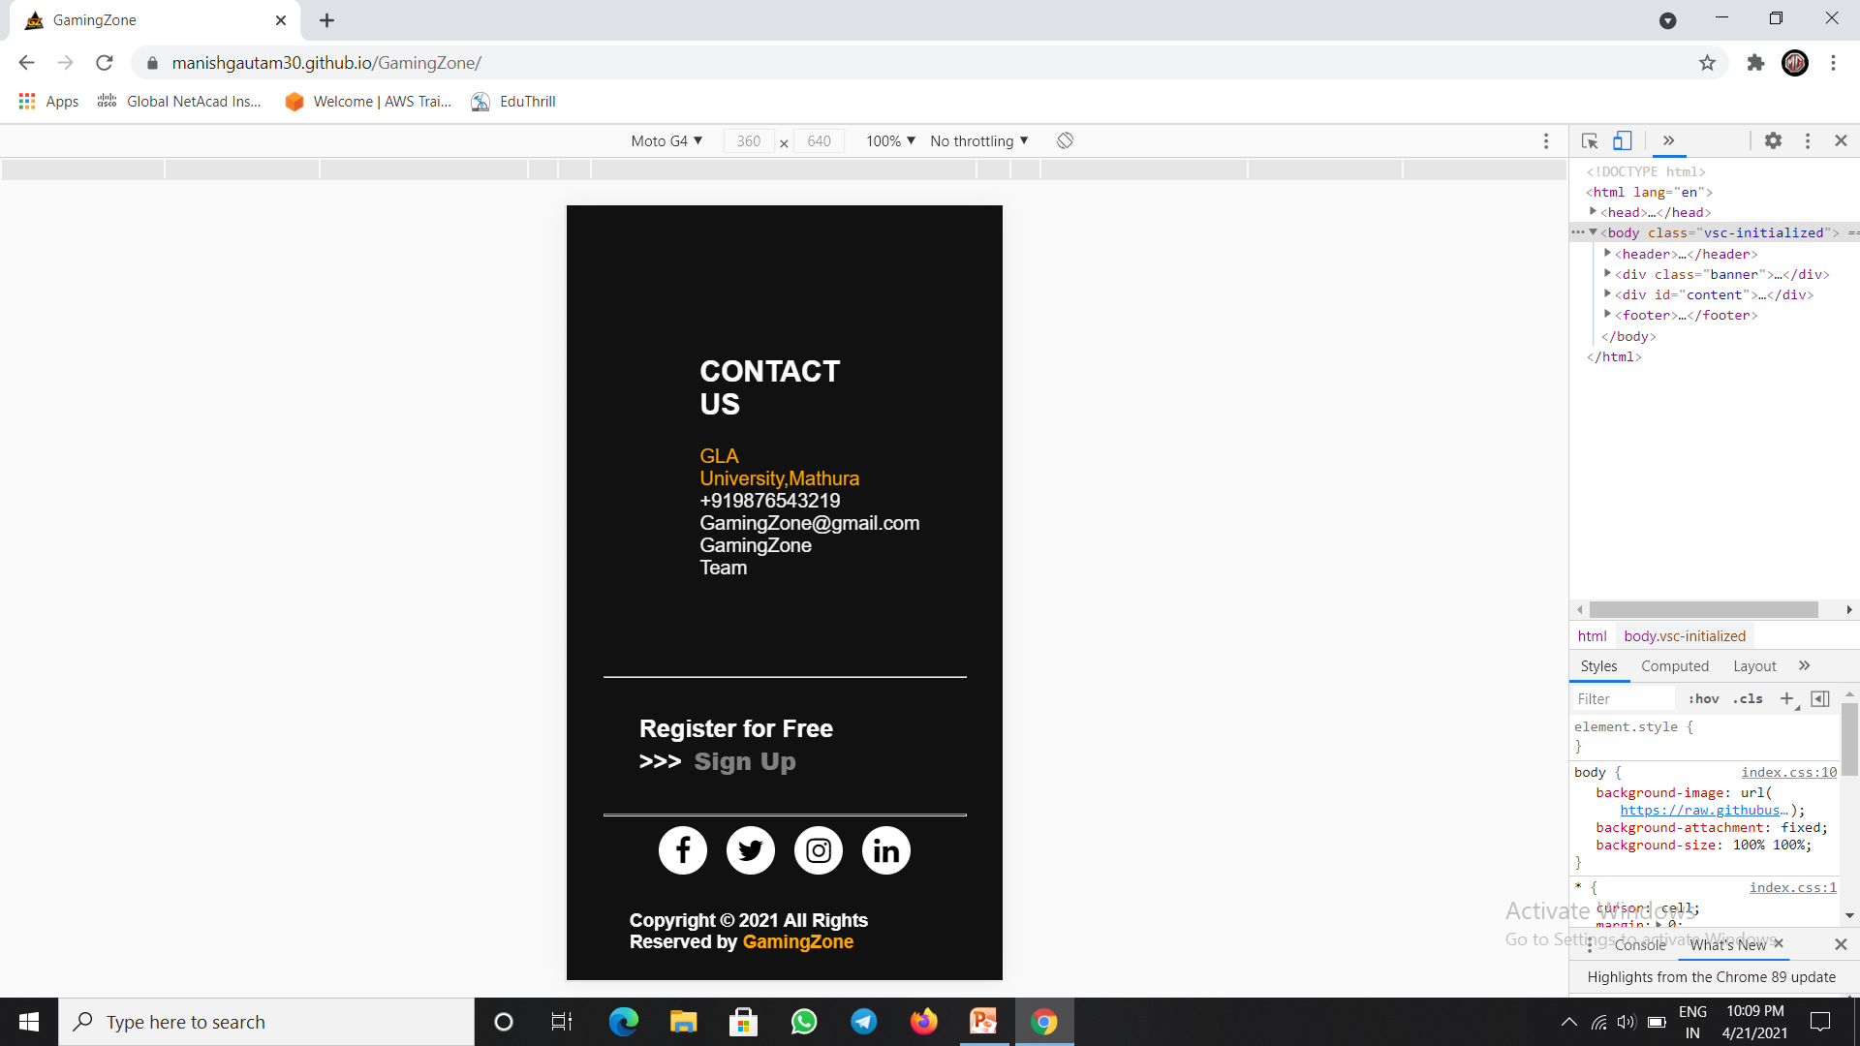
Footer is also made Responsive with respect to “ I Pad ” or any Tablet size Screen.
Footer made Responsive with respect to “ Moto G Phone ”

Slide 20
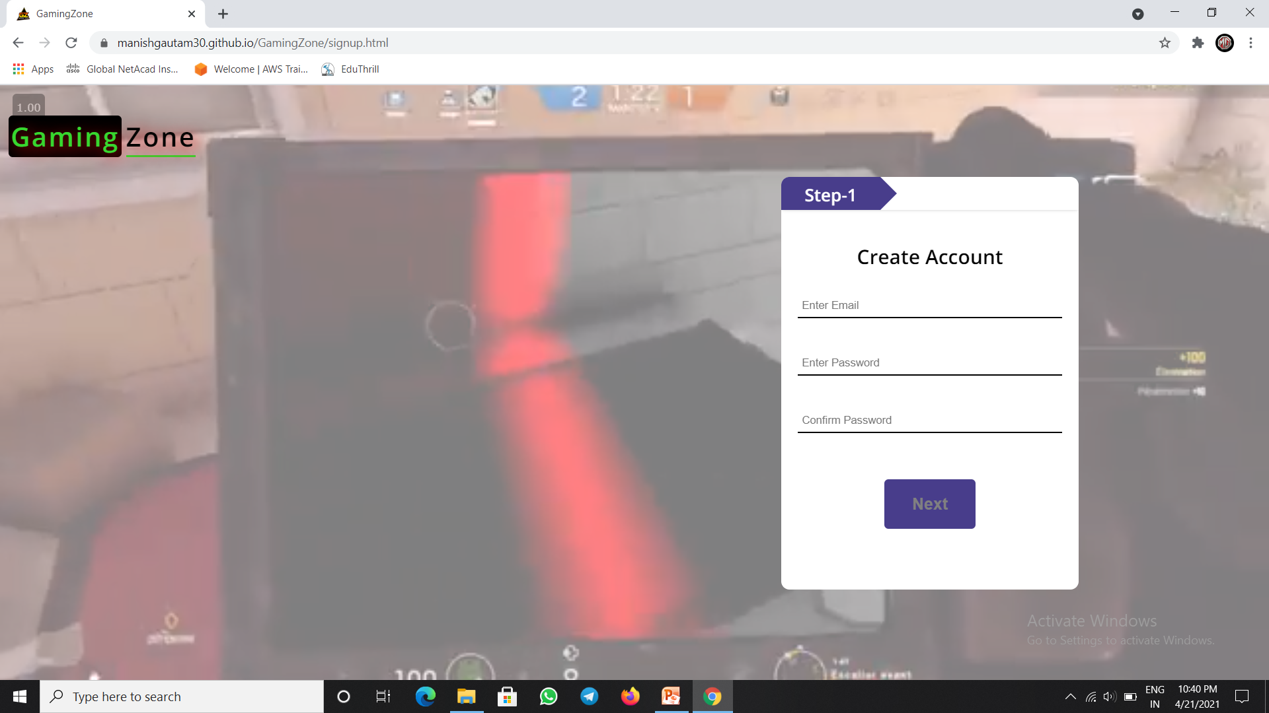
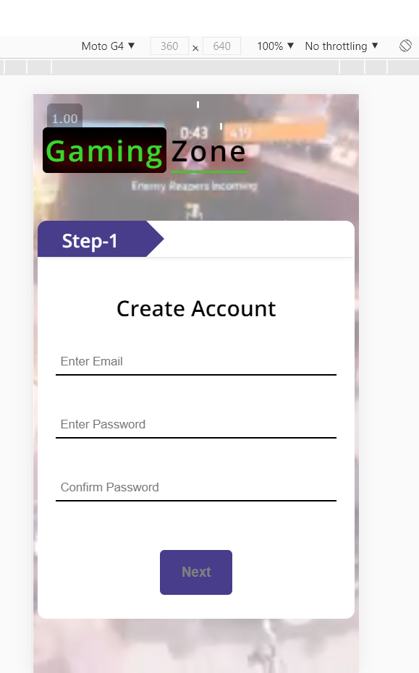
This is the Sign up activity with a logo Text icon on the top left corner also working as a home screen button on clicking it.
This is the Sign up activity set responsive with reference to the MOTO G phone.

Slide 21
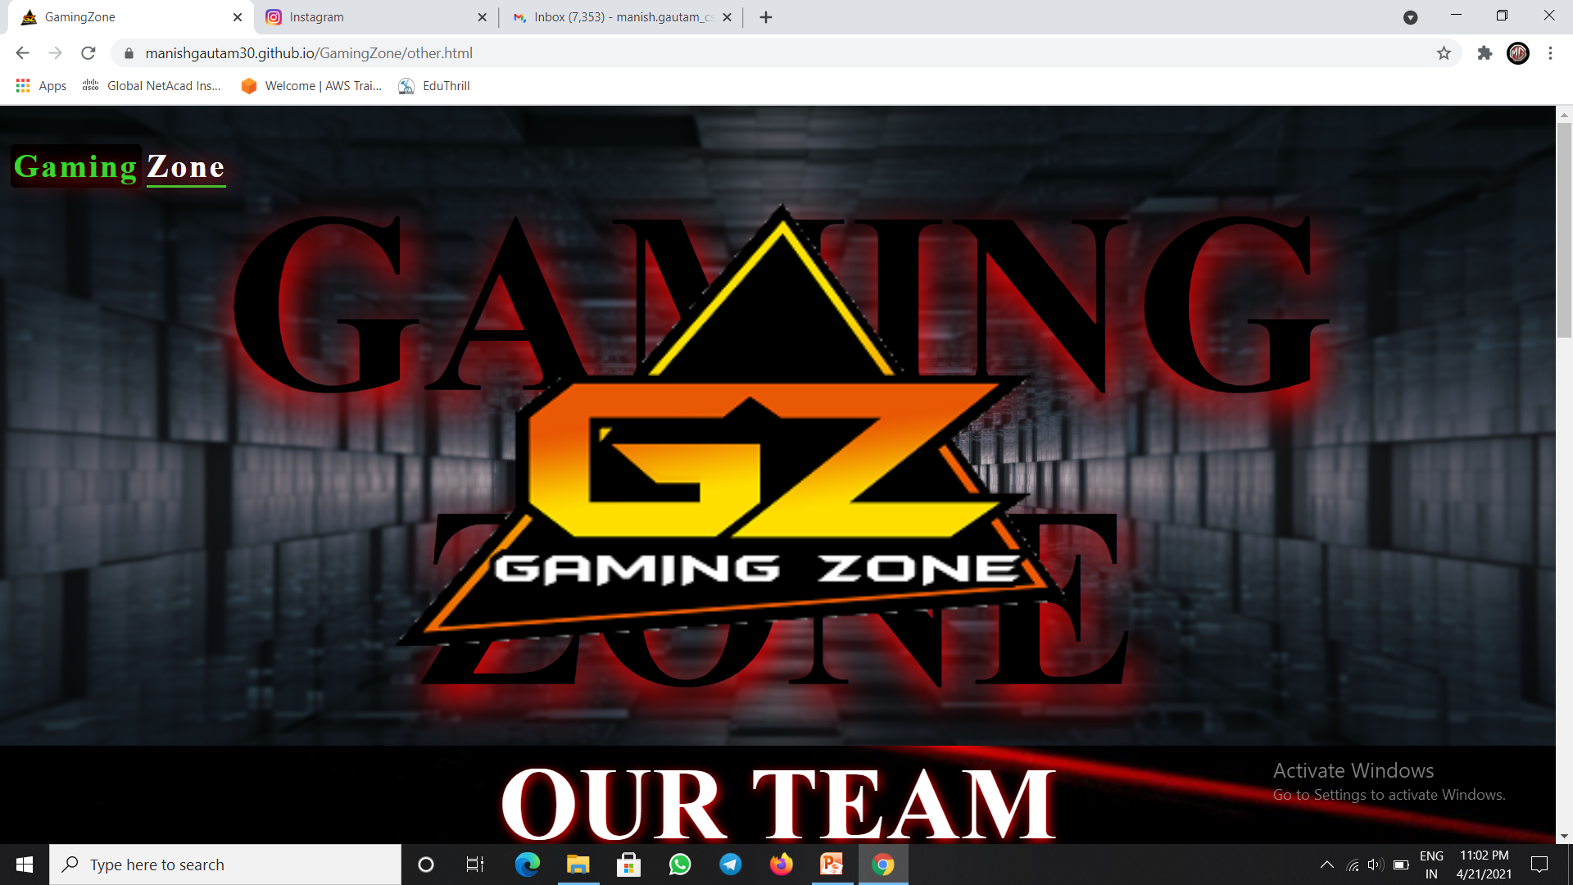
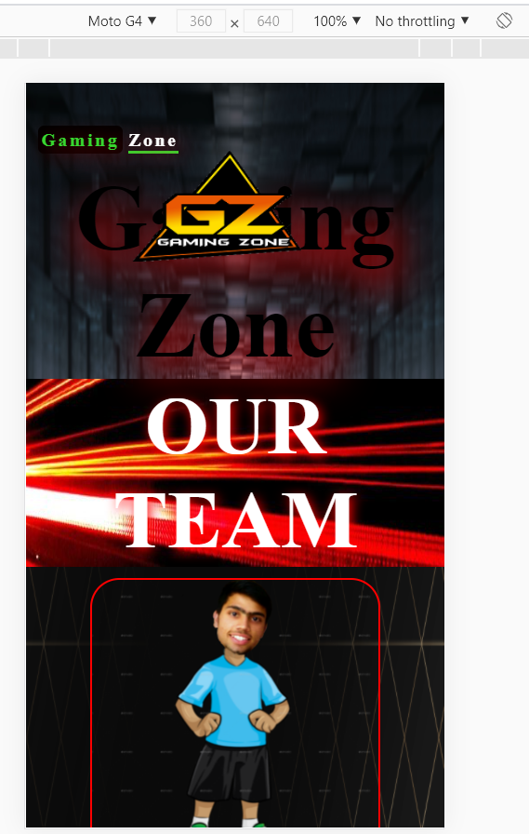
This is the about activity describing about us , our privacy Policy, and also about our team with a logo Text icon on the top left corner also working as a home screen button on clicking .
This is the about activity set responsive with reference to the MOTO G phone.

Slide 22
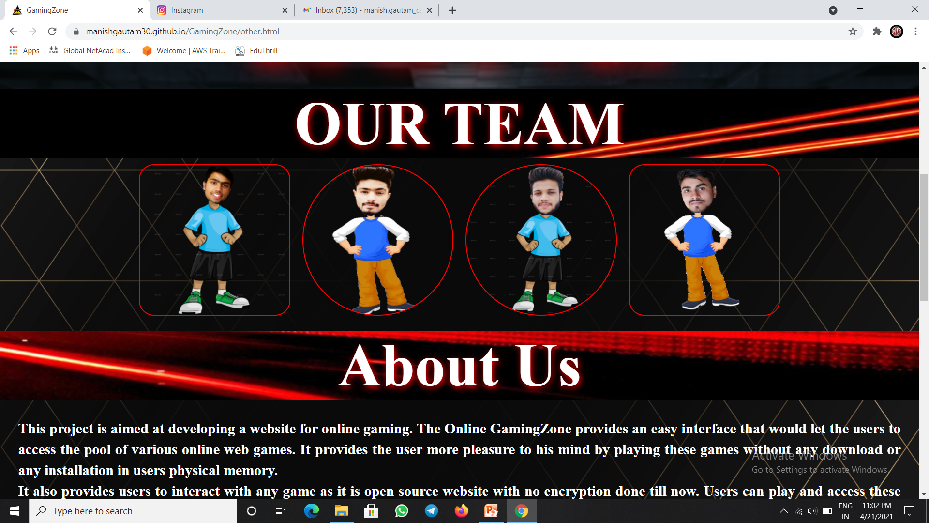
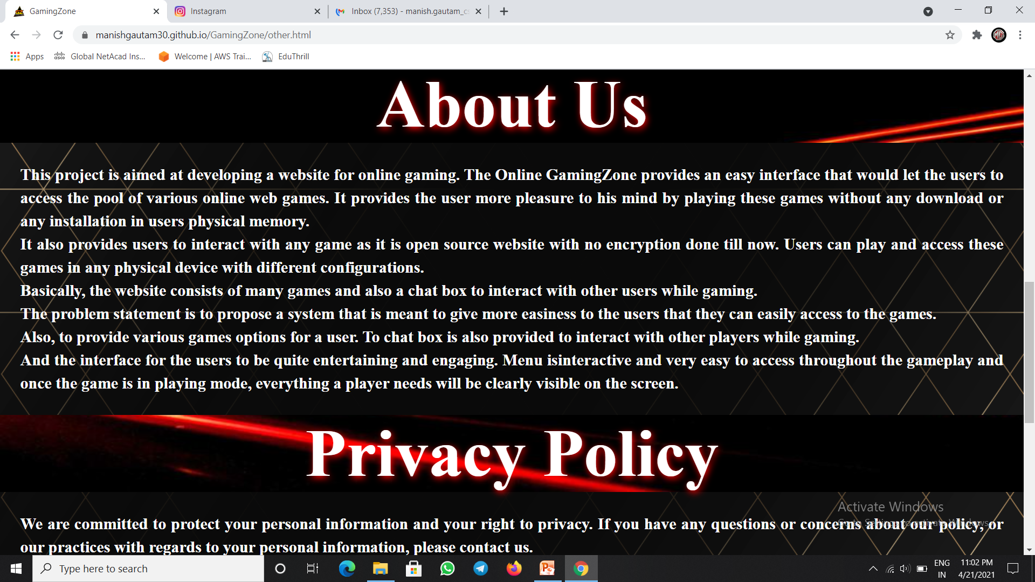
This is Our Team section and these image icons also work as the link to our GitHub Profiles.
This is about us section and the privacy policy section of our Gaming website .

Slide 23
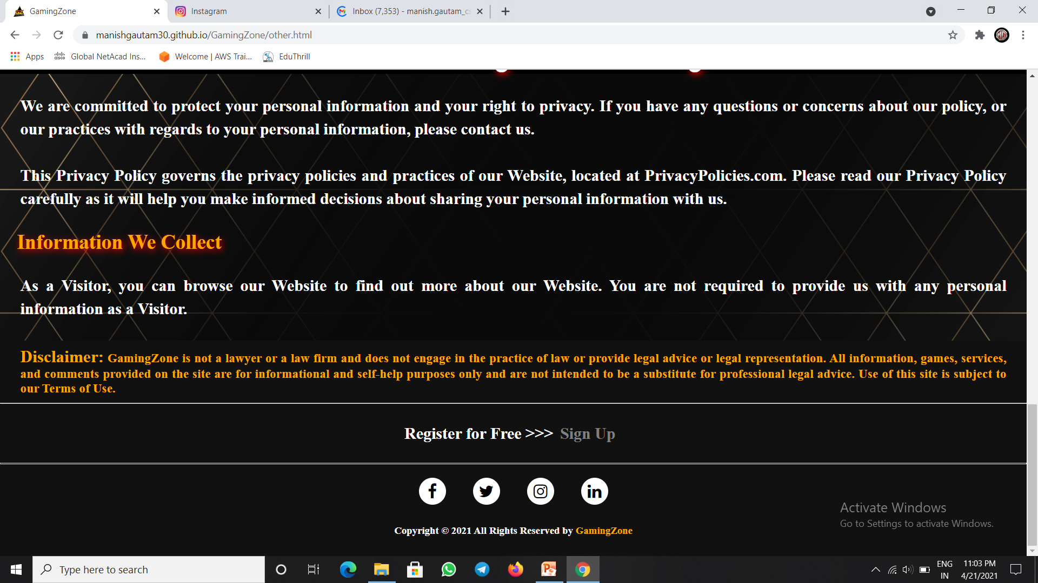
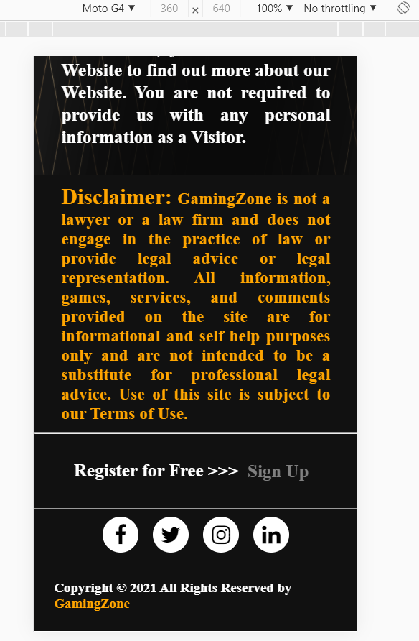
This is 2nd part of our privacy policy section and also contains the Disclaimer of our website and the Footer with all social links.
Responsive view of our website’s 2nd part of our privacy policy section.

Slide 24
Link for the code: https://github.com/manishgautam30/GamingZone
Link for the Gaming Website: https://manishgautam30.github.io/GamingZone

Slide 25
Thank You!

